Slide 1
File Organization

Slide 2
File Organization
The File is a collection of records. Using the primary key, we can access the records. The type and frequency of access can be determined by the type of file organization which was used for a given set of records.
File organization is a logical relationship among various records. This method defines how file records are mapped onto disk blocks.
File organization is used to describe the way in which the records are stored in terms of blocks, and the blocks are placed on the storage medium.
The first approach to map the database to the file is to use the several files and store only one fixed length record in any given file. An alternative approach is to structure our files so that we can contain multiple lengths for records.
Files of fixed length records are easier to implement than the files of variable length records.

Slide 3
Objective of file organization
It contains an optimal selection of records, i.e., records can be selected as fast as possible.
To perform insert, delete or update transaction on the records should be quick and easy.
The duplicate records cannot be induced as a result of insert, update or delete.
For the minimal cost of storage, records should be stored efficiently.

Slide 4
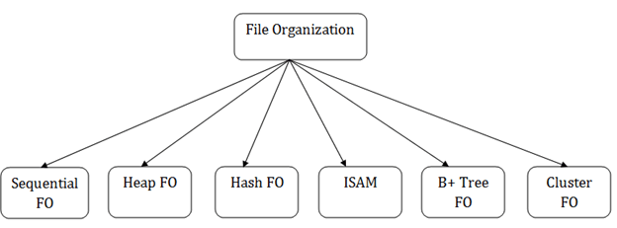
Types of file organization:
File organization contains various methods. These particular methods have pros and cons on the basis of access or selection. In the file organization, the programmer decides the best-suited file organization method according to his requirement.
Types of file organization are as follows:

Slide 5
Sequential File Organization
Heap File Organization
Hash File Organization
B+ Tree File Organization
Clustered File Organization
ISAM (Indexed Sequential Access Method)

Slide 6
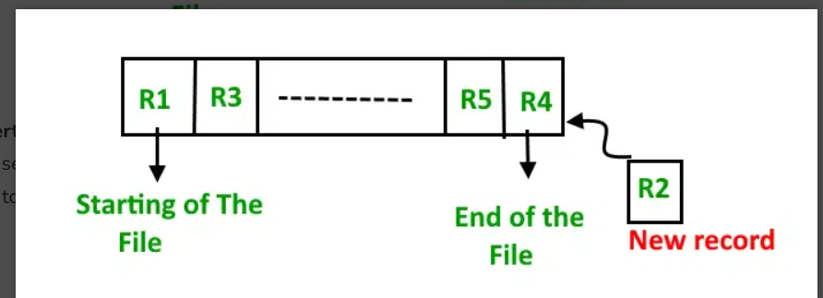
Sequential File Organization
The easiest method for file Organization is the Sequential method. In this method, the file is stored one after another in a sequential manner. There are two ways to implement this method:
1. Pile File Method
This method is quite simple, in which we store the records in a sequence i.e. one after the other in the order in which they are inserted into the tables.

Slide 7
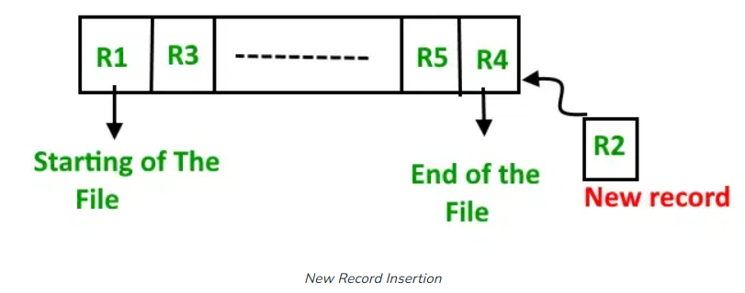
Insertion of the new record: Let the R1, R3, and so on up to R5 and R4 be four records in the sequence. Here, records are nothing but a row in any table. Suppose a new record R2 has to be inserted in the sequence, then it is simply placed at the end of the file.

Slide 8
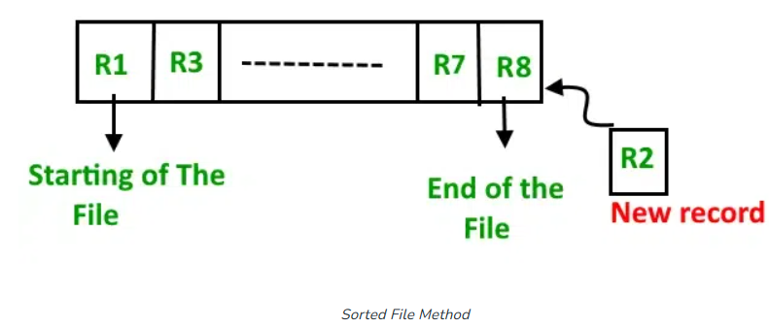
2. Sorted File Method
In this method, As the name itself suggests whenever a new record has to be inserted, it is always inserted in a sorted (ascending or descending) manner. The sorting of records may be based on any primary key or any other key.

Slide 9
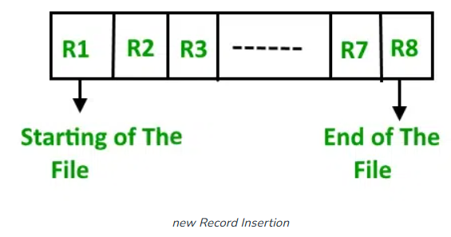
Insertion of the new record: Let us assume that there is a preexisting sorted sequence of four records R1, R3, and so on up to R7 and R8. Suppose a new record R2 has to be inserted in the sequence, then it will be inserted at the end of the file and then it will sort the sequence.

Slide 10
Advantages of Sequential File Organization
Fast and efficient method for huge amounts of data.
Simple design.
Files can be easily stored in magnetic tapes i.e. cheaper storage mechanism.
Disadvantages of Sequential File Organization
Time wastage as we cannot jump on a particular record that is required, but we have to move in a sequential manner which takes our time.
The sorted file method is inefficient as it takes time and space for sorting records.

Slide 11
Heap File Organization
It is the simplest and most basic type of organization. It works with data blocks.
In heap file organization, the records are inserted at the file's end. When the records are inserted, it doesn't require the sorting and ordering of records.
When the data block is full, the new record is stored in some other block.
This new data block need not to be the very next data block, but it can select any data block in the memory to store new records. The heap file is also known as an unordered file.
In the file, every record has a unique id, and every page in a file is of the same size.
It is the DBMS responsibility to store and manage the new records.

Slide 12
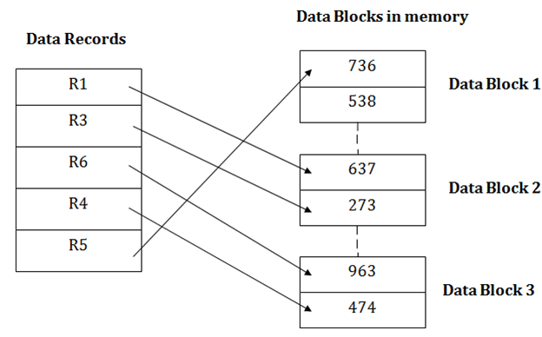

Slide 13
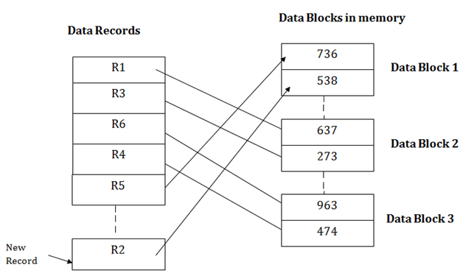
Insertion of a new record
Suppose we have five records R1, R3, R6, R4 and R5 in a heap and suppose we want to insert a new record R2 in a heap.
If the data block 3 is full then it will be inserted in any of the database selected by the DBMS, let's say data block 1.

Slide 14
If we want to search, update or delete the data in heap file organization, then we need to traverse the data from staring of the file till we get the requested record.
If the database is very large then searching, updating or deleting of record will be time-consuming because there is no sorting or ordering of records.
In the heap file organization, we need to check all the data until we get the requested record.

Slide 15
Advantages of Heap File Organization
It is a very good method of file organization for bulk insertion. If there is a large number of data which needs to load into the database at a time, then this method is best suited.
In case of a small database, fetching and retrieving of records is faster than the sequential record.
Disadvantages of Heap File Organization
This method is inefficient for the large database because it takes time to search or modify the record.
This method is inefficient for large databases.

